Slide 1
Variables & Data Types

Slide 2

Scenario
Salary List

Slide 3
Scenario
Salary List
₹1M
₹1.5M
₹1.8M
₹0.9M
₹1.6M
₹2M

Slide 4

Scenario
Salary List
₹1M
₹1.5M
₹1.8M
₹0.9M
₹1.6M
₹2M

Slide 5

Scenario
Salary List
Ramesh -- 1M
Suresh – 1.5M Krishna – 0.9M Rahul – 1.6M Swati – 1.8M Sam – 2M

Slide 6
Variables
Ramesh
= 1M
What are Variables?
Suresh
= 1.5M
Variables are names bounded to objects.
Krishna
Rahul Swati Sam
= 0.9M
= 1.6M
= 1.8M
= 2M

Slide 7
Variables
Ramesh
Suresh Krishna Rahul Swati Sam
= 1M
What are Variables?
= 1.5M
Variables are names bounded to objects.
= 0.9M
= 1.6M
= 1.8M
= 2M

Slide 8
Variables
Variables
Ramesh
= 1M
What are Variables?
Suresh
= 1.5M
Variables are names bounded to objects.
Krishna
= 0.9M
= 1.6M
= 1.8M
= 2M
Rahul
Swati
Sam

Slide 9
Variables in Python
Variable Assignment

Slide 10
Variables in Python
Variable Assignment
Variable_name = Value
A = 5
B = 10

Slide 11
Variables naming rules in Python
Python is case-sensitive
A=5
is different from
a=5

Slide 12
Variables naming rules in Python
Python is case-sensitive
A=5 is different from
a=5
Variable name cannot start with special character except underscore (_)
_sam=5 is valid

Slide 13
Variables naming rules in Python
Python is case-sensitive
A=5 is different from
a=5
Variable name cannot start with special character except underscore (_)
_sam=5 is valid
@sam=5 is invalid

Slide 14
Variables naming rules in Python
Python is case-sensitive
A=5 is different from
a=5
Variable name cannot start with special character except underscore (_)
_sam=5 is valid
@sam=5 is invalid
Variable name cannot start with a number
9sam =5
is invalid

Slide 15
Variables naming rules in Python
Python is case-sensitive
A=5 is different from
a=5
Variable name cannot start with special character except underscore (_)
_sam=5 is valid
@sam=5 is invalid
Variable name cannot start with a number
9sam =5
is invalid
sa9m =5
is valid

Slide 16
How do variables work?
a = 10
b = a a = 6
What is the value of a and b?

Slide 17
How do variables work?
10
a
a = 10
b = a a = 6
What is the value of a and b?

Slide 18
How do variables work?
10
a
a = 10
b = a
a = 6
b
What is the value of a and b?

Slide 19
How do variables work?
10
a = 10
b = a a = 6
b
6
a
What is the value of a and b?
Ans. a is 6 and b is 10

Slide 20
NOTE
It's considered best practice (PEP8) that names are lowercase.
Variable name should make sense.
Avoid using words that have special meaning in Python like "list" and "str"

Slide 21
my_dogs = 2
my_dogs = [ “Sammy” , “Frankie” ]
This is okay in Python!

Slide 22
my_dogs = 2
my_dogs = [ “Sammy” , “Frankie” ]
ERROR
in other Languages!

Slide 23
Pros of Dynamic Typing:
Very easy to work with
Faster development time
Cons of Dynamic Typing:
May result in bugs for unexpected data types!
You need to be aware of type()

Slide 24
Basic Data Types

Slide 25
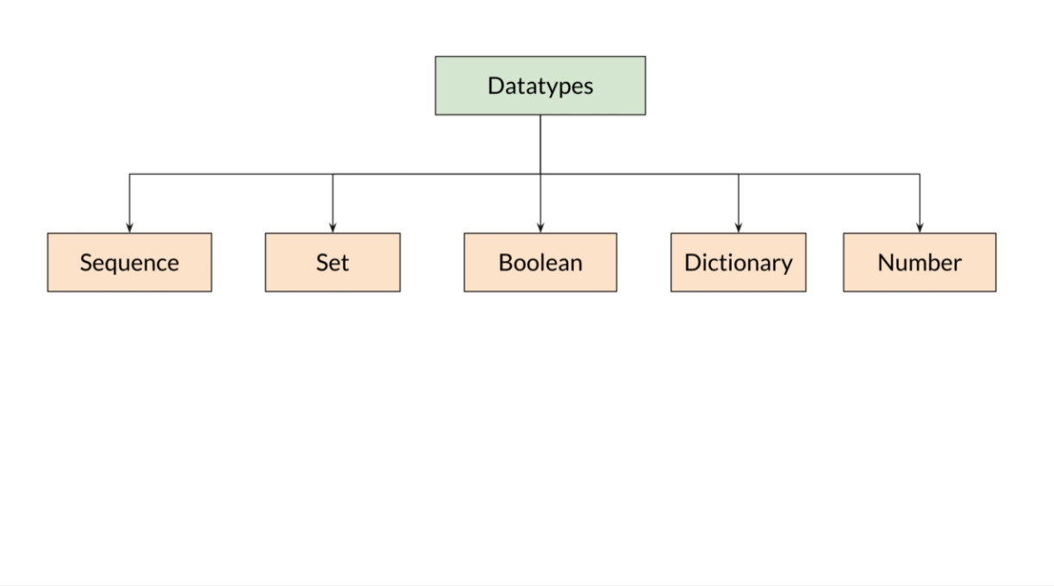

Slide 26
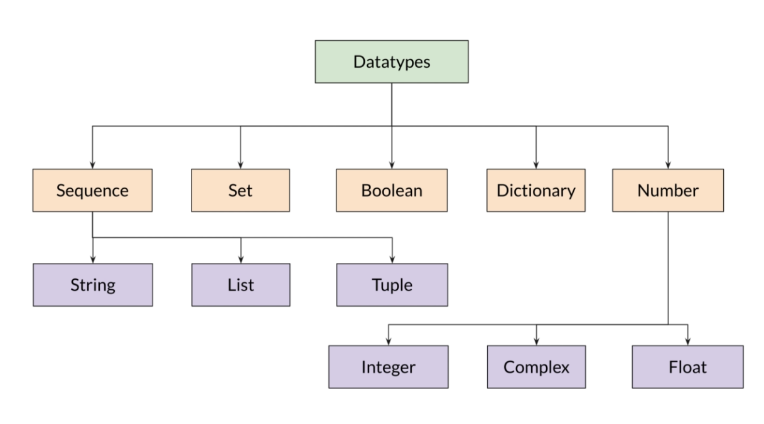

Slide 27
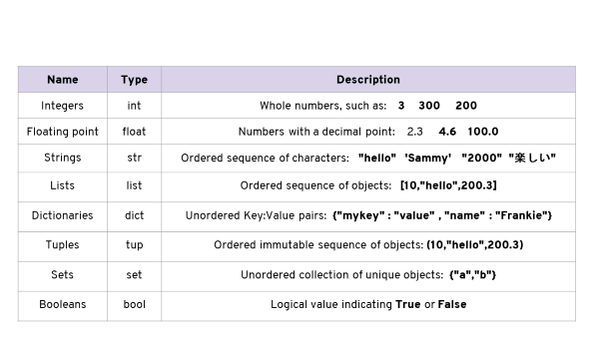

Slide 28
Numbers: Store numerical information and come in two forms:
Integers - Whole Numbers
Floating Point - Numbers with a decimal
Strings: Ordered sequence of characters
Lists: Ordered sequence of objects (mutable)
Tuples: Ordered sequence of objects (immutable)
Dictionary: Key-Value pairing that is unordered.
Sets : unordered collections of unique elements

